Slide 1



SMART WATER BOTTLE REVOLUTIONIZING HYDRATION WITH IOT

Slide 2

TEAM DETAILS
Abhishek Singh - 22BIT0314
Dhruv Deepak Agarwal - 22BIT0562
Medidala Aditya - 22BIT0503
Moningi Rohit - 22BIT0088
01

Slide 3
ABSTRACT
Our project presents a smart water bottle system that leverages IoT technology to monitor hydration in real-time. By combining an ultrasonic sensor, Arduino Uno, Python FastAPI, and AWS cloud services, users gain continuous insights into their water intake. This encourages healthier habits and reduces dependency on single-use plastics. The integration of technology and sustainability highlights the smart bottle's role in enhancing both wellness and eco-consciousness.
02

Slide 4
PROBLEM STATEMENT
Dehydration remains a common health issue due to inconsistent water intake and lack of awareness. Current hydration tracking methods are manual, inaccurate, or ignored. Furthermore, excessive reliance on plastic water bottles worsens environmental pollution.
03

Slide 5
OBJECTIVE
To develop a smart water bottle that provides real-time hydration monitoring.
To enable cloud-based analytics for personalized water intake tracking.
To promote sustainable hydration habits using reusable bottles.
To visualize water intake patterns and encourage consistent drinking behavior.
04

Slide 6

GAP IDENTIFICATION
Current Limitations in Existing Solutions
Our Innovation Bridges These Gaps
Lack of accurate, sensor-based hydration tracking.
Minimal or no real-time cloud integration for user data.
Absence of personalized hydration insights and analytics.
Limited focus on sustainability and eco-friendly usage.
Integrates precise ultrasonic sensing with cloud-based data processing.
Offers real-time visualization via AWS-hosted dashboards.
Encourages personal wellness through actionable insights.
Promotes eco-conscious habits with a reusable, smart hydration system.
05

Slide 7
INNOVATION
The Smart Water Bottle project introduces a comprehensive IoT-based hydration monitoring solution that distinguishes itself from conventional hydration aids. It combines ultrasonic sensing, Arduino microcontroller technology, cloud computing (via AWS EC2), and web-based real-time data visualization. This integrated system enables precise tracking of water consumption, something most existing solutions fail to achieve with the same level of automation and connectivity.
Moreover, the use of Python FastAPI ensures efficient and lightweight communication between the hardware and the cloud server. This offers users an interactive experience that enhances engagement and promotes consistent healthy hydration habits. Additionally, the project aligns with sustainability goals by encouraging the use of reusable smart bottles instead of single-use plastics.
06

Slide 8
MARKET OPPORTUNITY
The market for health-focused smart devices is experiencing significant growth, driven by increasing consumer awareness of wellness, fitness, and preventive healthcare. Within this domain, hydration remains a critical but often overlooked component. Our solution directly addresses this gap by offering a practical, intelligent, and eco-friendly way to monitor and manage daily water intake.
There is a substantial opportunity to position this product within the broader wearable and smart health device market. Potential customer segments include athletes, fitness enthusiasts, working professionals, and individuals managing specific health conditions. Additionally, collaborations with health tech companies, gyms, wellness centers, and environmental sustainability campaigns can further expand reach and impact.
The convergence of health technology, cloud computing, and environmental consciousness presents a strong foundation for market entry, scalability, and long-term relevance.
07

Slide 9
PROTOTYPE DEMONSTRATION
The prototype of our Smart Water Bottle system showcases the practical implementation of an end-to-end IoT solution for real-time hydration tracking. It integrates hardware, software, and cloud components to provide seamless user interaction and data visibility.
Hardware Components:
An ultrasonic sensor is installed inside the bottle cap to measure the water level based on the time delay of reflected sound waves.
An Arduino Uno microcontroller captures these readings and processes the sensor data locally.
Data Communication & Processing:
The Arduino transmits data to a Python FastAPI server, which acts as a lightweight and efficient interface for receiving and managing sensor data.
The server is hosted on an AWS EC2 instance, ensuring scalable and reliable data processing.
08

Slide 10
PROTOTYPE DEMONSTRATION
Cloud Integration & Visualization:
The processed data is stored and visualized through a web-based dashboard hosted .
Users can view real-time water level data, historical trends, and personalized hydration insights from any internet-enabled device.
User Experience:
The dashboard presents intuitive graphs and metrics, allowing users to monitor their hydration status throughout the day.
Alerts and notifications can be integrated in future versions to remind users to drink water at regular intervals based on their consumption patterns.
This prototype not only validates the technical feasibility of the concept but also demonstrates its potential to be transformed into a market-ready smart hydration product.
09

Slide 11
WORKFLOW
The workflow of our Smart Water Bottle system is designed to ensure seamless interaction between hardware, software, and user interface components. It follows a structured, step-by-step data flow from physical sensing to user-level visualization.
Water Level Detection:The ultrasonic sensor placed on the bottle cap continuously measures the distance to the water surface, detecting the current water level.
Microcontroller Processing: The sensor data is read and processed by an Arduino Uno. This ensures local validation and prepares the data for transmission.
Data Transmission to Cloud: The processed readings are sent to a Python FastAPI backend via serial communication and local network connectivity.
Cloud Storage & Analysis:The FastAPI server, hosted on an AWS EC2 instance, receives and stores the data for real-time and historical analysis.
10

Slide 12
WORKFLOW
User Interaction:
Users can view their hydration data, monitor trends, and adapt their drinking habits accordingly—forming a complete feedback loop.
11

Slide 13
PRODUCT WORKING
The Smart Water Bottle operates as a real-time hydration monitoring system by integrating embedded sensing with cloud-based data processing and visual reporting.
Sensor Operation: The ultrasonic sensor, embedded in the cap of the bottle, emits sound waves to measure the distance between the cap and the water surface. As the water level changes, these distance values are dynamically updated.
Local Computation: The Arduino Uno reads the sensor input, performs initial processing, and forwards the data through a serial interface to the host system connected to the internet.
Backend Infrastructure: A Python FastAPI server runs on an AWS EC2 instance, handling all data reception and storage. It provides endpoints for the frontend to access hydration metrics securely and in real-time.
Web Interface: The frontend is developed using standard web technologies and runs independently without a hosting service like Amplify. It retrieves data from the backend, rendering real-time charts that reflect user water consumption and daily progress.
12

Slide 14
PRODUCT WORKING
Frontend Visualization: A custom-built frontend (HTML, CSS, JavaScript) fetches data from the backend and displays it on a user dashboard with interactive charts and trend indicators.
Real-Time Feedback: Users receive immediate feedback on their water intake status, enabling them to track progress toward hydration goals and improve their drinking habits.
This modular yet tightly integrated design ensures reliability, accuracy, and user accessibility, making the product practical for everyday use.
13

Slide 15
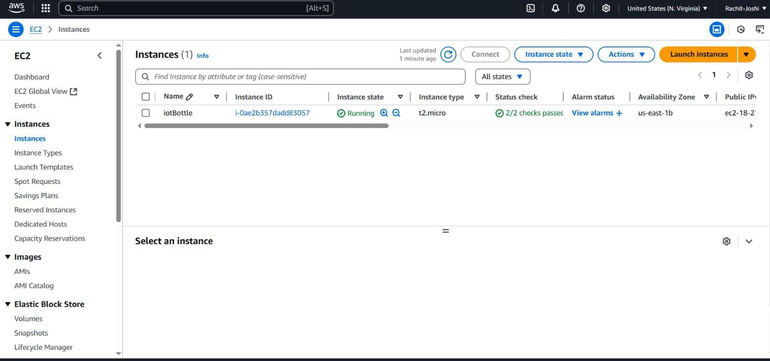
EC2 INSTANCE
14

Slide 16
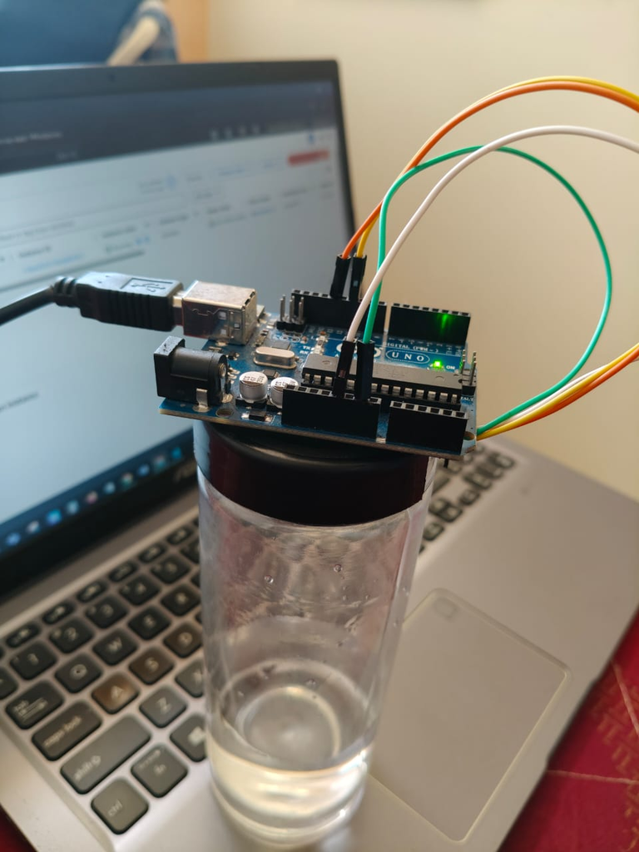
PRODUCT
15

Slide 17
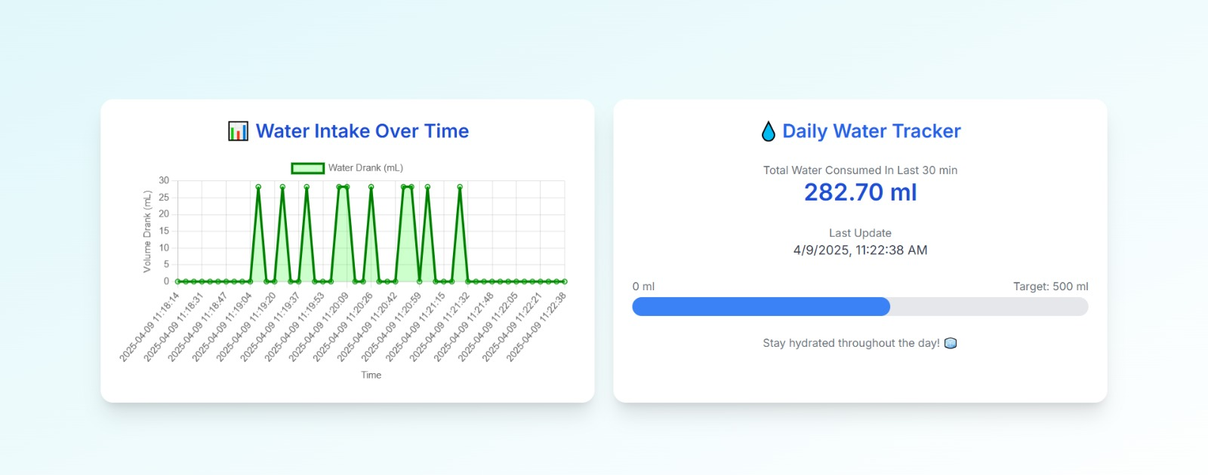
RESULTS
16

Slide 18
CONCLUSION
The Smart Water Bottle project showcases an effective IoT-based solution for promoting healthy hydration habits. By integrating sensors, cloud processing, and a custom web dashboard, it offers real-time insights into water intake.
Beyond health benefits, the product also supports sustainability by encouraging the use of reusable bottles. The system's modular design allows for future upgrades, including AI-based recommendations and mobile app integration.
This prototype lays the groundwork for a scalable, user-friendly smart hydration device.
17

